Slide 1
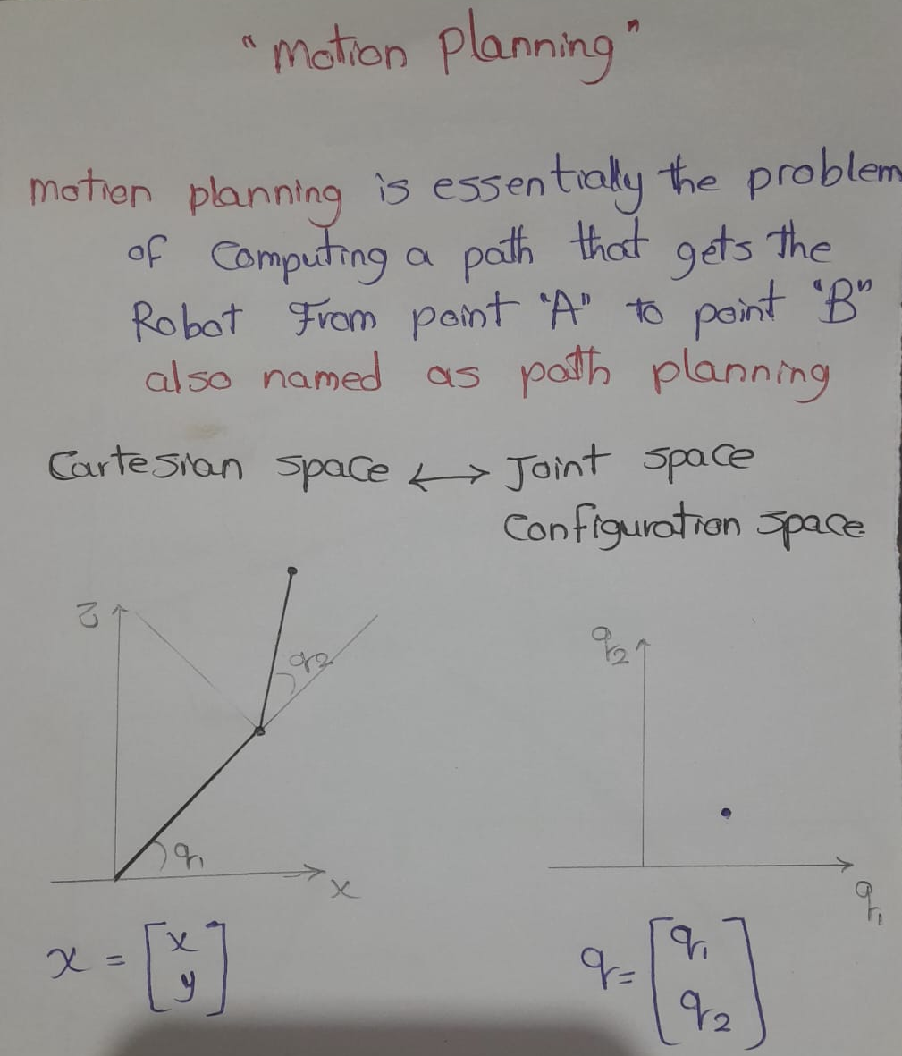

Slide 2
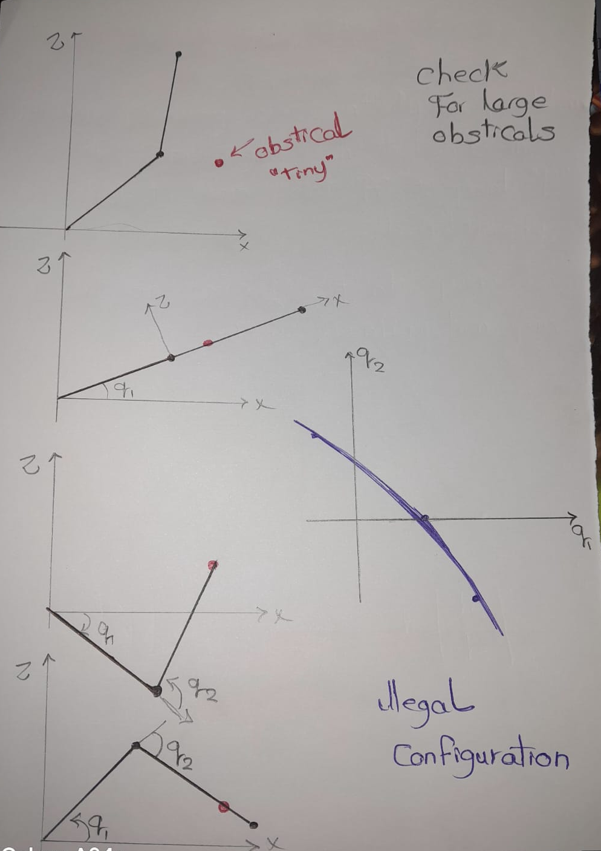

Slide 3
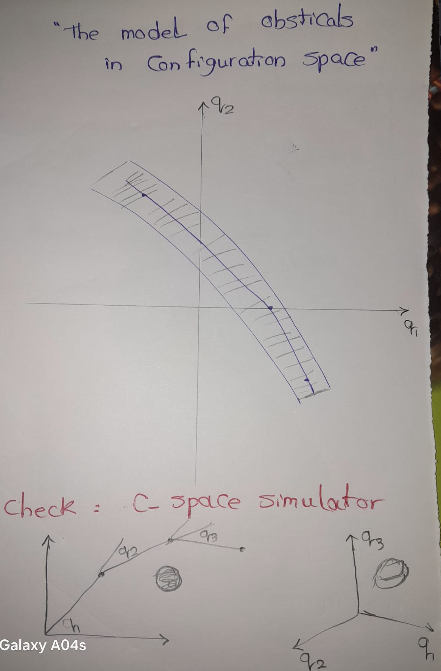

Slide 4
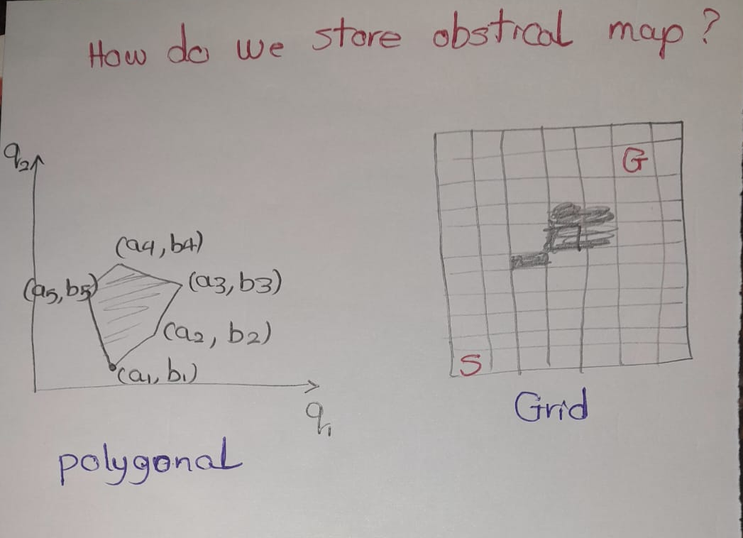

Slide 5
Motion Planning – Arms vs. Mobile Robots
Arms
High-dimensional C-space (often 6-dimensional)
Discretizing map into grid is not tractable
Polygonal C-space obstacle map very hard to compute
Knowing “where” you are on the map is generally easy
Mobile Robots
Low-dimensional C-space (often 2-dimensional)
Discretizing map into grid is tractable and often done
Polygonal obstacle map can be available (e.g. floorplan)
Knowing “where” you are on the map is generally hard

Slide 6
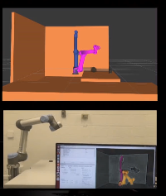
Motion Planning For ROBOT ARM
Not easy to plot the obsticals in the joint space.
We check for sample of random points.
Asnwer the question are these point queries in collision

Slide 7
Sampling-based motion planning
Take random sampling, of doing random exploration of the Configuration space,( stochastic motion planning algorithms.)
Take the advatage of the ability to check the collision at any point.
Random exploration is very powerful especially in higher dimension robots

Slide 8
Rapidly-exploring Random Trees (RRT)
Input: start and goal point in C-space
Output: path from start to goal
Algorithm
Insert start point in tree
While tree can not connect to goal:
– Sample random point r in C-space
– Find point p in tree that is closest to r
– Add branch of predefined length from p in direction of r
– If new branch intersects obstacle:
• discard new branch (or shorten)
Compute path from start to goal through tree
Shortcut path: for any two points in path, add direct line unless direct line intersects an obstacle

Slide 9
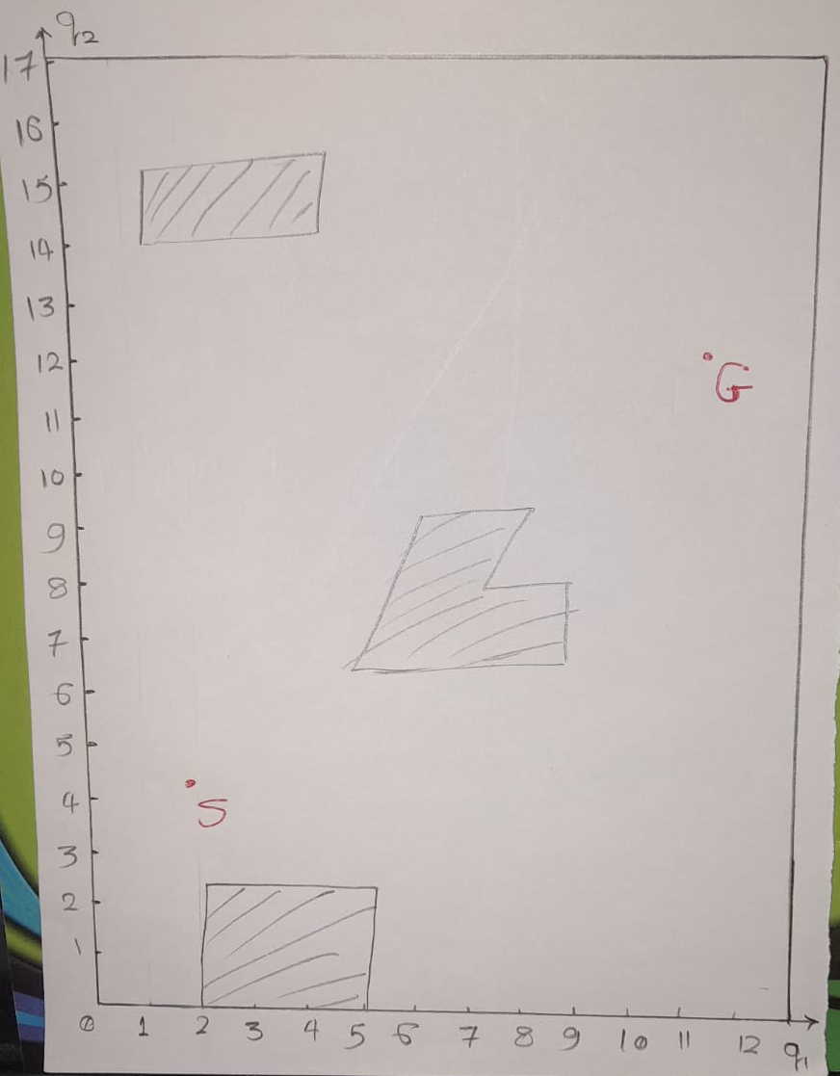

Slide 10
Probabilistic Roadmaps (PRM)
Map construction:
While number of points in roadmap lower than threshold:
sample random point in C-space
if new point is not in collision:
connect new point to all other points in the roadmap via lines, as long as lines do not intersect obstacles.
Input: start and goal point in C-space
Output: path from start to goal

Slide 11
Probabilistic Roadmaps (PRM)
Path finding:
connect start point to nearest point in roadmap such that
connecting line does not intersect obstacle
connect goal point to nearest point in roadmap such that
connecting line does not intersect obstacle
find a path between start and goal going exclusively on the roadmap

Slide 13
Sampled-based Motion Planning
Quickly check for any point in C-space is illegal or not.
Many versions are probabilistically complete: if a path is excist it will be found in finite time.
We can’t grantee that:
1. time will be small or very long
2. the quality of the solution meaning we can’t grantee that path is the shortest : the solution is the post-preprocessing to eliminate the zigs and zags

